Slide 1


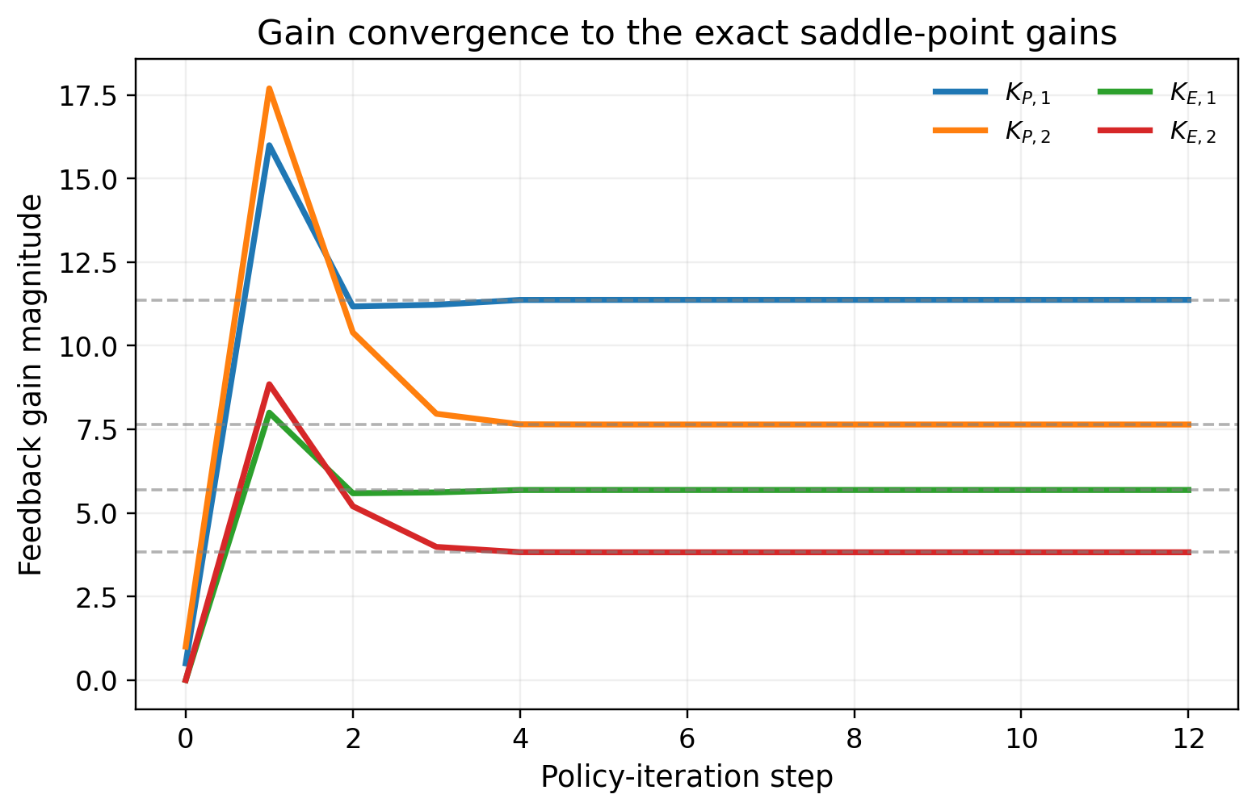
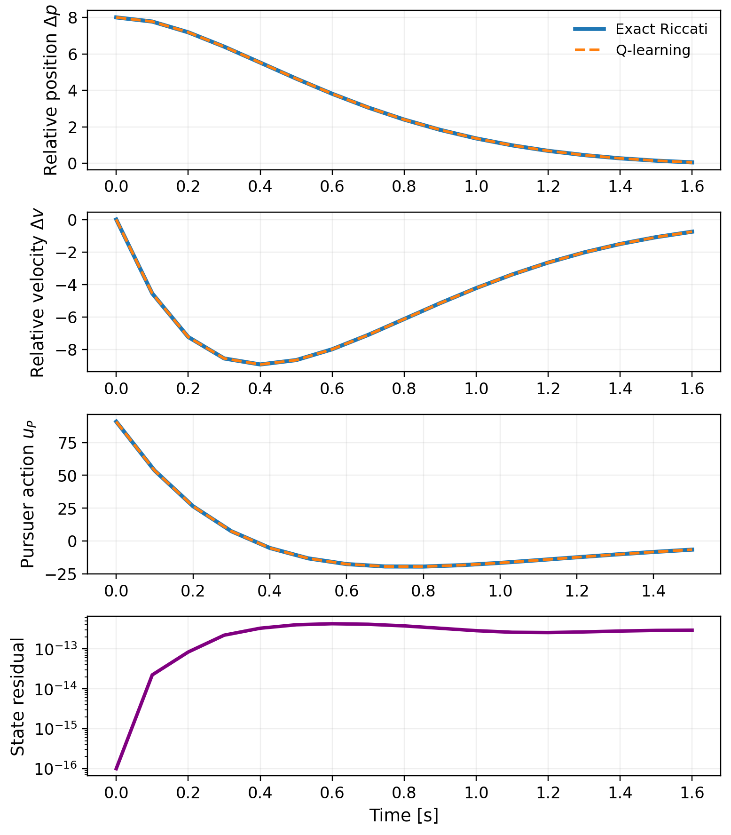
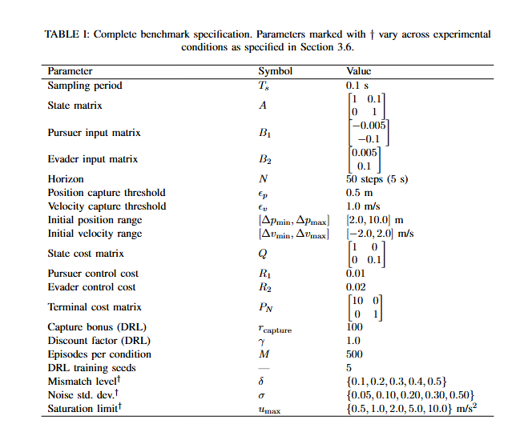
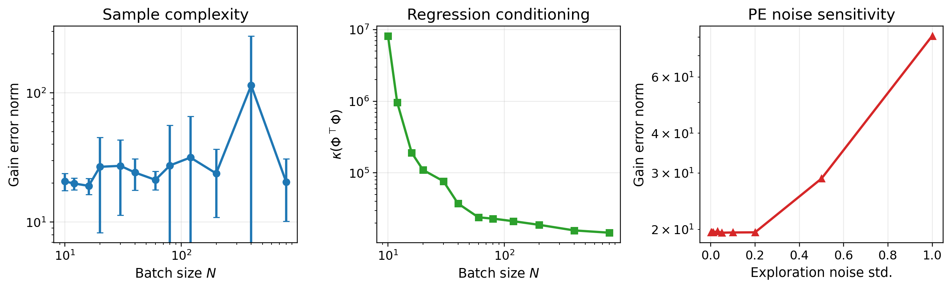
Model-Based and Learning-Based Pursuit-Evasion Control: A Benchmark Comparison of Linear-Quadratic Game Theory and Deep Reinforcement Learning
Blaine Swieder, Dr. Syed Ali Asad Rizvi, Department of Electrical & Computer Engineering, Tennessee Technological University
Abstract
This thesis aims to develop a controlled pursuit-evasion benchmark for comparing two controller-design philosophies on the same system. More specifically, an exact finite-horizon linear-quadratic (LQ) dynamic game controller and a learning-based pursuer that is trained from sampled interaction. The benchmark is formulated in one-dimensional relative coordinates, with shared dynamics, shared state variables, and shared evaluation metrics. The analytical baseline is derived from a zero-sum finite-horizon game, while the learned controller is trained against the fixed Nash evader that is generated by the same Riccati sweep. The objective is not to propose a new RL algorithm, rather, it is to formulate a benchmark in which learned behavior can be judged directly against an exact game-theoretic reference. The thesis is organized around nominal performance and structured perturbations including model mismatch, additive process noise, and actuator saturation.
Results so Far
Learned gains converge to the exact Riccati gains in about 4-5 policy updates.
Learned and exact trajectories match to plotting resolution.
State residual remains at machine precision.
Nominal Metrics are identical: Capture Rate = 1.00, Mean Capture Time = 14.46, Mean Total Cost = 279.447, and Mean Total Energy = 9506.055.
Fig. 1: Learned pursuer and evader gains converge to the exact Riccati saddle-point gains.
Motivation and Research Gap
Autonomous interaction is fundamentally multi-agent and often adversarial.
Pursuit-Evasion gives a clean framework for closing vs. escaping behavior.
Prior literature often shows the following: Analytical Game Solutions, or RL pursuit-evasion behavior, but rarely compares both on the same benchmark.
Objectives
Build a shared benchmark with common dynamics, costs, and metrics.
Derive the exact LQ saddle-point baseline.
Test whether a data-driven Bellman method can recover that controller from data.
Uses this as the nominal baseline for later robustness studies.
Benchmark Overview
State: Relative Position and Relative Velocity
Both agents are modeled as discrete-time double integrators.
Episodes end at capture or at a fixed-horizon.
Shared assumptions enable a controlled comparison.
Fig. 2: Learned and Exact Trajectories coincide to plotting resolution; residual stays at machine precision.
Key Takeaway & Next Steps
The main result so far is a validated nominal baseline.
On a matched LQ benchmark, Bellman-based learning recovers the exact saddle-point policy from data alone.
Next steps, model mismatch, process noise and input saturation.
Methods and Contributions
Exact Baseline: Finite-horizon zero-sum LQ saddle-point controller from backward Riccati recursion.
Data-Driven Method: Bellman-based state-feedback Q-learning, not PPO, for the Chapter 6 nominal study.
The Q-Function is modeled as a quadratic form and fit by least-squares Bellman regression.
Gains are extracted analytically from the learned Q-matrix.
References
R. Isaacs, Differential Games, 1965.
T. Basar and G. J. Olsder, Dynamic Noncooperative Game Theory, 1999.
F. L. Lewis and D. Vrabie, “Reinforcement Learning and Adaptive Dynamic Programming for Feedback Control,’ 2009.
R. S. Sutton and A. G. Barto, Reinforcement Learning: An Introduction, 2018.
A. Al-Tamimi, F. L. Lewis, and M. Abu-Khalaf, “Model-Free Q-Learning Designs for Linear Discrete-Time Zero-Sum Games,” 2007.
S. A. A. Rizvi and Z. Lin, Output Feedback Reinforcement Learning Control for Linear Systems, 2023.
Fig 3: Engineering diagnostics for data-driven recovery; that is, larger batch sizes improve conditioning, while excessive exploration noise increases gain-recovery.

